Slide 1



Link Life Connect: Organ Donation and Procurement Network Management System
Discover how the Link Life Connect system revolutionizes organ donation and procurement management. By leveraging cutting-edge technologies and a user-friendly interface, the system facilitates seamless coordination and communication among hospitals, government organizations, and patients.
by Vishal Mustare

Slide 2
Key Technologies
MySQL 8
HTML 5
The system utilizes the latest version of MySQL, ensuring robust and reliable data management.
With HTML 5, the system delivers a modern and interactive user interface.
Python
Flask Framework
Python plays a vital role in powering the system's backend functionality.
The Flask framework provides a solid foundation for developing the system's web application.

Slide 3
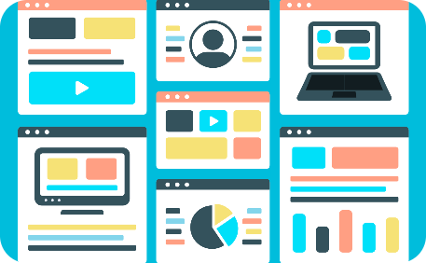


Enhanced User Experience
Sleek & Intuitive Interface
Streamlined Hospital Workflow
Data Insights
Experience a seamless and user-friendly interface that simplifies organ donation and procurement management.
Gain valuable insights through in-depth statistical analysis of transplantation transactions.
Optimize collaboration between hospitals, ensuring efficient communication and accurate record-keeping.

Slide 4

User Registration & Authorization
1
Exclusive Accounts
A government-certified hospital can create a unique account, enhancing security and accountability.
2
Authorized Access
Only registered hospitals have the privilege to request donation or procurement transactions.
3
Government Oversight
Government organizations monitor donor-patient pairings and ensure compliance with transplantation regulations.

Slide 5

Efficient Transplantation Process
1
Precise Matching
Advanced algorithms ensure accurate pairing of donors and patients for optimal transplantation success rates.
2
Timely Approvals
Government organizations expedite the approval process, streamlining transplantation operations.
3
Comprehensive History
Collect valuable statistical data by tracking the history of transplantation transactions, enabling continuous improvement.

Slide 6
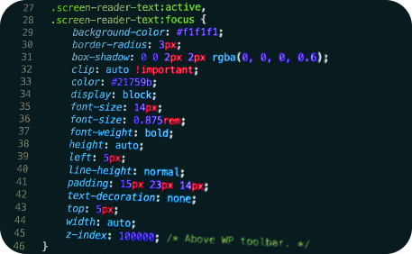
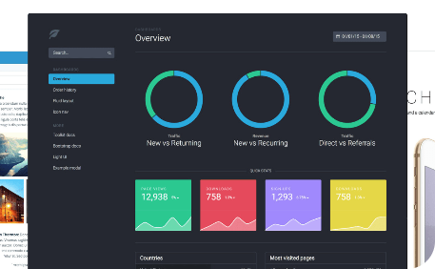

Wide Range of Technologies
CSS
Bootstrap
Javascript
CSS ensures visually appealing and responsive design for the Link Life Connect system.
The powerful Bootstrap framework accelerates development, ensuring consistency and scalability.
Leverage the power of Javascript to create dynamic and interactive functionalities.

Slide 7

Streamlined Data Management
Seamless Integration
Effortlessly connect and integrate various data sources within the Link Life Connect system.
Reliable Performance
The system's robust data management ensures high reliability, even during peak usage hours.
Efficient Storage
Optimize storage utilization, allowing seamless scaling as the system grows.

Slide 8

Secure & Confidential
1
Rigorous Security Measures
The Link Life Connect system implements robust security protocols to protect sensitive data.
2
Access Control
Government organizations ensure only authorized personnel have access to confidential information.
3
Data Encryption
All data transmitted and stored within the system is encrypted, safeguarding patient privacy.

Slide 9
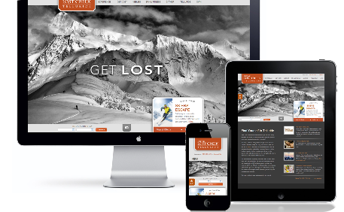
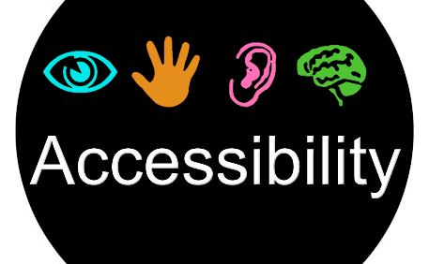
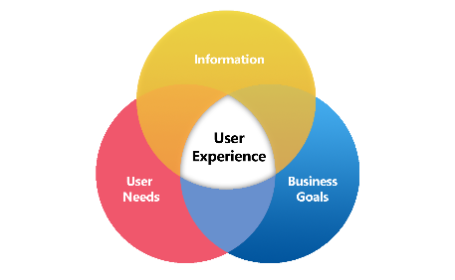
Responsive & Accessible Design
Seamless Mobile Experience
Inclusive Accessibility
User-Centric Approach
The system prioritizes accessibility, ensuring an inclusive experience for users of all abilities.
Feedback-driven design creates an intuitive system that meets the needs of its diverse user base.
Enjoy a seamless experience across a wide range of devices, including smartphones and tablets.

Slide 10

Continuous System Optimization
1
Proactive Maintenance
Regular maintenance and updates keep the Link Life Connect system running smoothly and efficiently.
2
User Feedback Integration
The system actively incorporates user feedback to drive iterative improvements and enhancements.
3
Future-Proof Architecture
Scalable and adaptable, the system's architecture supports future growth and technological advancements.

Slide 11

Transforming Organ Donation & Procurement
1
Elevating Efficiency
With the Link Life Connect system, organ donation and procurement processes are streamlined, revolutionizing the healthcare industry.
2
Saving Lives
By enhancing communication and coordination, the system plays a pivotal role in saving and improving countless lives.
3
Promoting Collaboration
The system fosters collaboration between hospitals, government organizations, and patients, creating a unified ecosystem dedicated to the noble cause of organ transplantation.

Slide 12
System architecture
Components:
i. Frontend
Developed with HTML5, CSS, Bootstrap, and JavaScript.
User-friendly interface for donors, recipients, and healthcare professionals.
ii. Web Application
Built with Flask framework in Python.
Manages server-side logic, processes requests, and communicates with the database.
iii. RESTful API
Exposed by Flask for seamless communication between frontend and backend.
Supports CRUD operations for managing donor and recipient information.
iv. Business Logic
Implements core functionalities: donor-recipient matching, organ allocation, compliance.
Developed in Python.
v. Database Management System (DBMS)
MySQL 8.0 for storing and managing donor, recipient, and organ procurement data.
Ensures data integrity.
vi. Security Layer
Integrates encryption protocols (HTTPS), user authentication, and authorization mechanisms.
Ensures confidentiality and integrity of sensitive information.

Slide 13
Implementation
i. Backend Development
Implemented using Python with Flask framework.
Covered donor-recipient matching, organ allocation, and regulatory compliance.
ii. Database Implementation
MySQL 8.0 database setup with an efficient schema.
Developed queries for data storage, retrieval, and management.
iii. Frontend Development
Created a responsive and user-friendly interface.
Utilized HTML5, CSS, Bootstrap, and JavaScript.

Slide 14
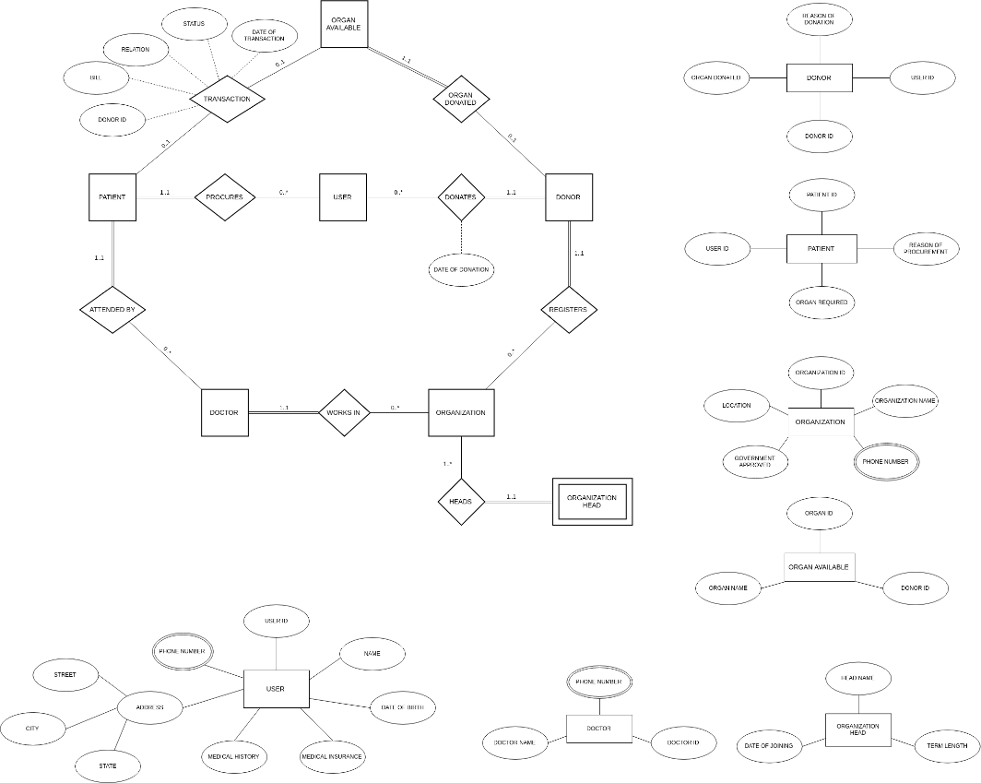
ER Diagram

Slide 15
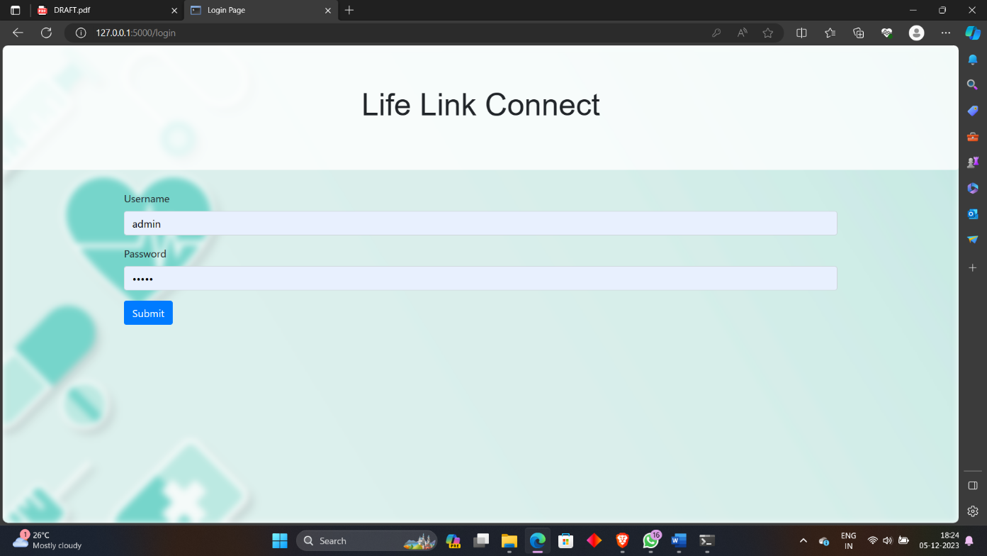
Working

Slide 16
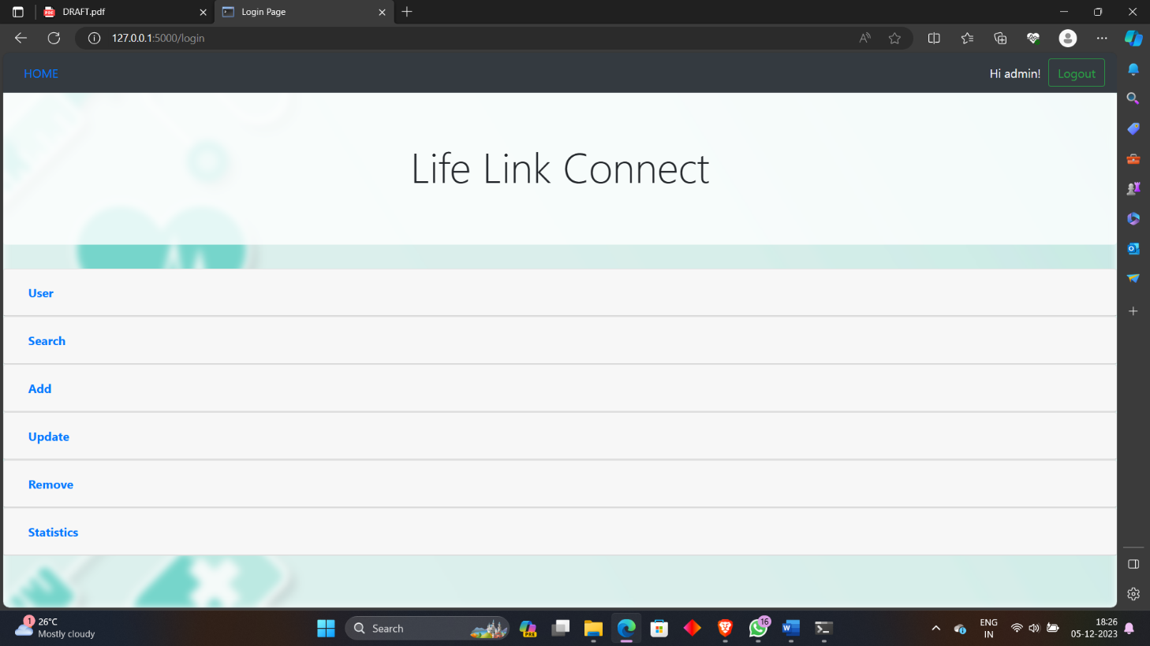

Slide 17
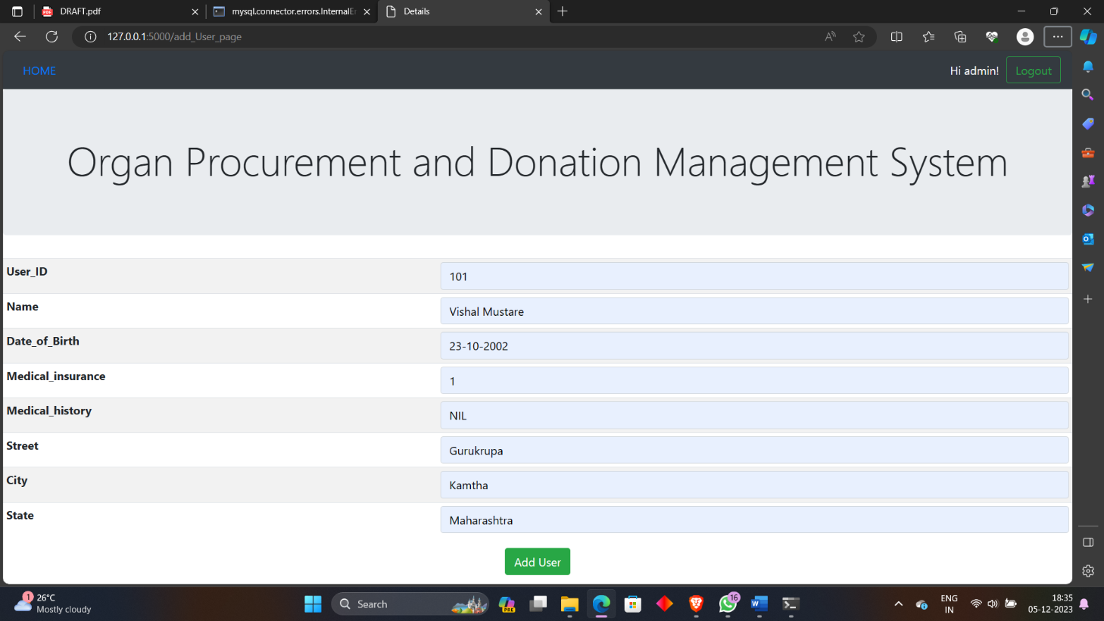

Slide 18
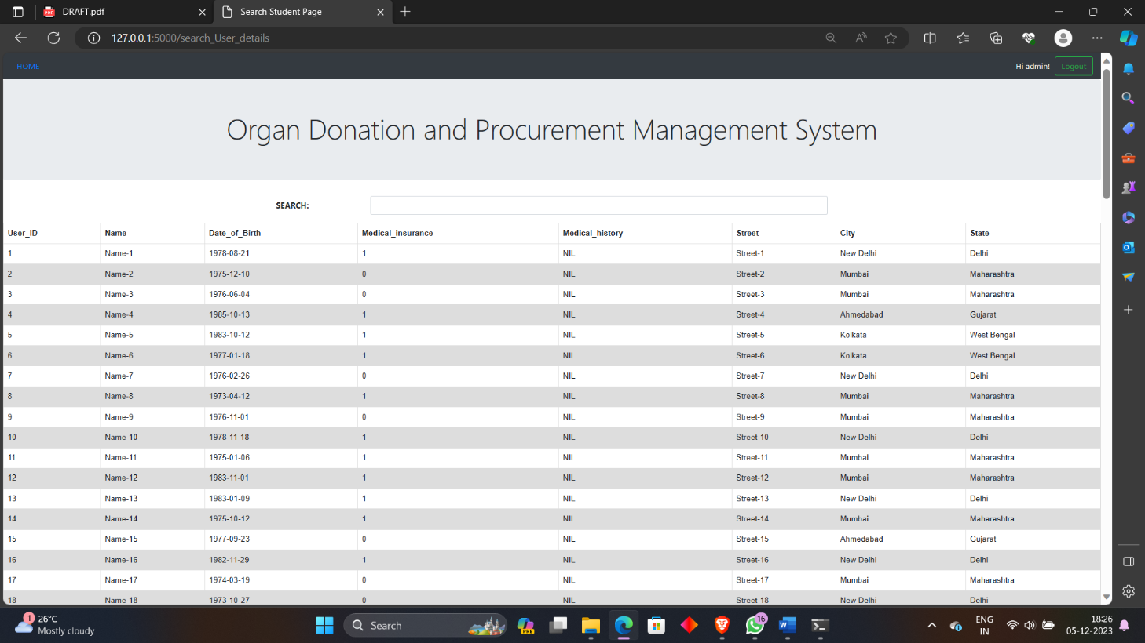

Slide 19
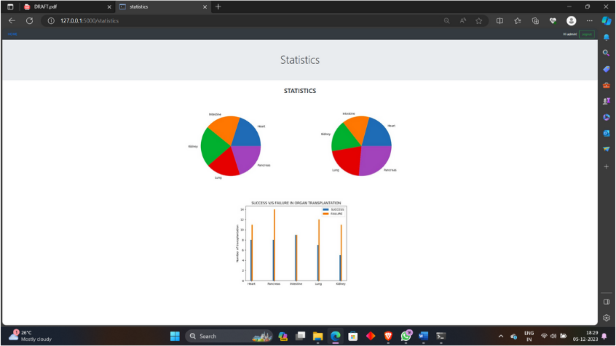

Slide 20
Future Scope
Improved GUI
Enhanced Data Visualization
Expanded Query Options
Accommodate More Transactions
Intelligent Donor-Patient Matching
Personalized Recommendations
Geographic Mapping
Mobile Accessibility
Real-time Updates
User Feedback Mechanism

Slide 21

Conclusion
In conclusion, the Organ Procurement and Donation Management System, developed with Python, Flask, MySQL, HTML5, CSS, and Bootstrap, stands as a milestone in optimizing organ transplantation processes. Its commitment to efficiency, security, and user-friendly design, coupled with rigorous testing and refinement, underscores its potential to revolutionize organ donation. With robust backend logic, secure database management, and an intuitive frontend, the system is poised to address critical issues in healthcare planning and organ wastage. The transition to user acceptance testing marks a significant stride toward establishing a transparent and efficient organ donation ecosystem, reflecting a meaningful contribution to healthcare advancement.

